Slide 1


Fast RCNN
=============================================================================
WWW.THEMLLABS.COM || contact@themllabs.com || Phone : 91-7338339898, 91-6362546088

Slide 2
Agenda
Fast RCNN
Architecture
Convolution layer
Region Proposal Network (RPN)
Bounding boxes and classes prediction
=============================================================================
WWW.THEMLLABS.COM || contact@themllabs.com || Phone : 91-7338339898, 91-6362546088

Slide 3
Fast RCNN
Fast RCNN is an object detection architecture presented in 2015 which uses convolution neural network.
It was presented by Ross Girshick, Shaoqing Ren, Kaiming He and Jian Sun.
It has become the famous object detection architecture like YOLO, SSD (Single shot Detector) etc.
=============================================================================
WWW.THEMLLABS.COM || contact@themllabs.com || Phone : 91-7338339898, 91-6362546088

Slide 4
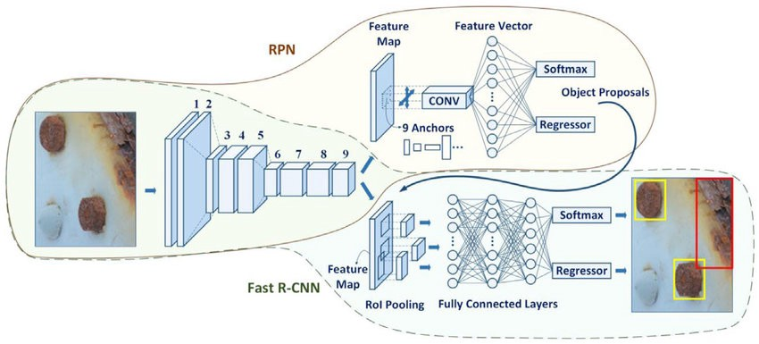
Architecture
It is divided into 3 parts, Convolution layer, RPN, Classes and bounding box detection.
=============================================================================
WWW.THEMLLABS.COM || contact@themllabs.com || Phone : 91-7338339898, 91-6362546088

Slide 5
Convolution layer
In the convolution layer, the filters are trained to extract the appropriate features of the image.
For example, training the filters to extract the appropriate features for a human face, then those filters are going to learn the training shapes and colors that are exist in the human face.
=============================================================================
WWW.THEMLLABS.COM || contact@themllabs.com || Phone : 91-7338339898, 91-6362546088

Slide 6
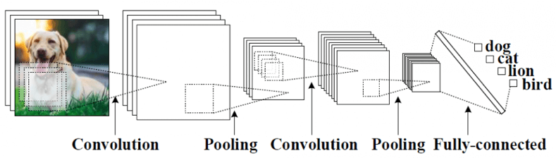
Convolution networks are generally composed of Convolution layers, pooling layers and at last fully connected which will be used for classification or detection.
=============================================================================
WWW.THEMLLABS.COM || contact@themllabs.com || Phone : 91-7338339898, 91-6362546088

Slide 7
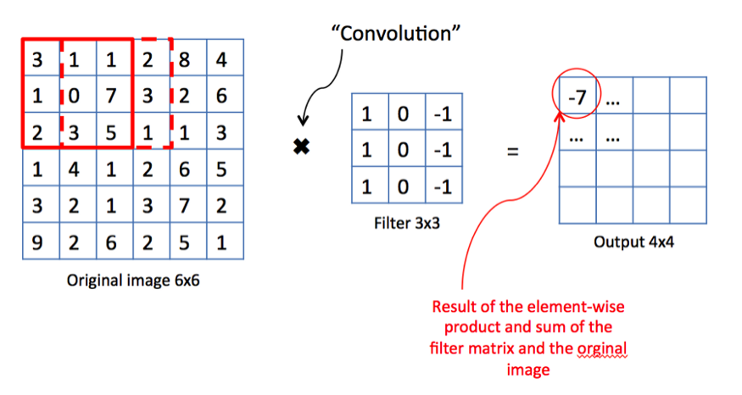
Computing convolution involves sliding the filter along the input image and the result is two dimensional matrix which is feature map.
=============================================================================
WWW.THEMLLABS.COM || contact@themllabs.com || Phone : 91-7338339898, 91-6362546088

Slide 8
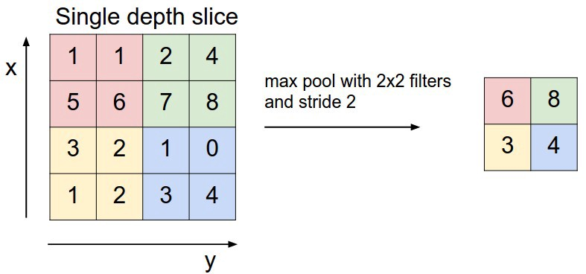
Pooling consists of decreasing quantity of features in the features map by eliminating pixels with low values.
Fully connected layer to classify features are not important in fast RCNN
=============================================================================
WWW.THEMLLABS.COM || contact@themllabs.com || Phone : 91-7338339898, 91-6362546088

Slide 9
Region Proposal Network (RPN)
Regional proposal network is the small neural network sliding on the last feature map of the convolution layers.
It will predict whether there is an object or not and also predict the bounding box of those objects.
=============================================================================
WWW.THEMLLABS.COM || contact@themllabs.com || Phone : 91-7338339898, 91-6362546088

Slide 10
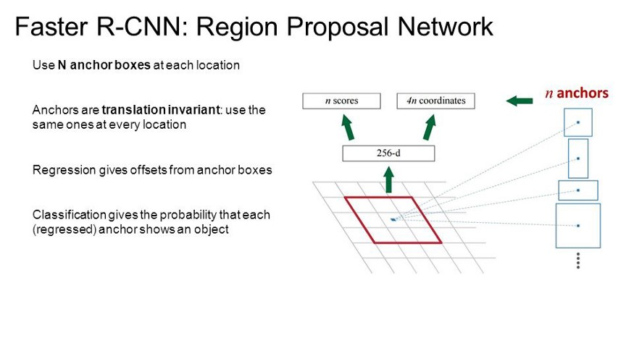
=============================================================================
WWW.THEMLLABS.COM || contact@themllabs.com || Phone : 91-7338339898, 91-6362546088

Slide 11
Bounding boxes and classes prediction
Another fully connected neural networks takes regions proposed by the RPN as an input and predict object class (Classification) and bounding boxes (Regression).
To train the fast RCNN architecture, SGD is used to optimize convolution layer filters, RPN weights and fully connected layer weights.
=============================================================================
WWW.THEMLLABS.COM || contact@themllabs.com || Phone : 91-7338339898, 91-6362546088

Slide 12
Thank you
=============================================================================
WWW.THEMLLABS.COM || contact@themllabs.com || Phone : 91-7338339898, 91-6362546088

